Slide 1









My Number Interactive Workbook
$$×$$
$$\frac{1}{2}$$
$$÷$$
$$+$$
$$−$$
$$\frac{3}{5}$$
$$7$$
Name
Class
Teacher
Term 1 Semester 1
$$5^{2}$$
$$\sqrt{9}$$
1

Slide 2
Create your own front page
It needs to contain the following –
My number interactive notebook
Name
Class
Teachers Name
Semester 1 Term 1
Page number 1

Slide 3
Contents
Glossary or Formula Page
Page
Date
Description
2
3

Slide 4
Tasks
24
7
30
Essential Question
Questions
Notes
Summary
4
5

Slide 5
24
7
30
Date
Index Notation
EQ – How do I calculate the value of an integer to the power of a positive integer?

Slide 6
24
7
30
Date
Index Notation
EQ – How do I calculate the value of an integer to the power of a positive integer?
What is the multiplication index law?
$a^{m}$ x $a^{n}$ = $a^{m+n}$

Slide 7
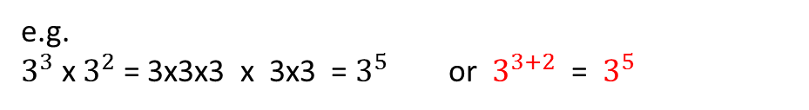
24
7
30
Date
Index Notation
EQ – How do I calculate the value of an integer to the power of a positive integer?
What is the multiplication index law?
$a^{m}$ x $a^{n}$ = $a^{m+n}$
e.g.
$3^{3}$ x $3^{2}$ = 3x3x3 x 3x3 = $3^{5}$ or $3^{3+2}$ = $3^{5}$

Slide 8

24
7
30
Date
Index Notation
EQ – How do I calculate the value of an integer to the power of a positive integer?
What is the multiplication index rule?
$a^{m}$ x $a^{n}$ = $a^{m+n}$
e.g.
$3^{3}$ x $3^{2}$ = 3x3x3 x 3x3 = $3^{5}$ or $3^{3+2}$ = $3^{5}$
What is the division index rule?
$a^{m}$ ÷ $a^{n }$ = ${a }^{m−n}$

Slide 9
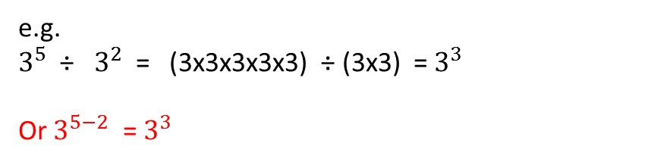
24
7
30
Date
Index Notation
EQ – How do I calculate the value of an integer to the power of a positive integer?
What is the multiplication index rule?
$a^{m}$ x $a^{n}$ = $a^{m+n}$
e.g.
$3^{3}$ x $3^{2}$ = 3x3x3 x 3x3 = $3^{5}$ or $3^{3+2}$ = $3^{5}$
What is the division index rule?
$a^{m}$ ÷ $a^{n }$ = ${a }^{m−n}$
e.g.
$3^{5}$ ÷ $3^{2}$ = (3x3x3x3x3) ÷ (3x3) = $3^{3}$
Or $3^{5−2}$ = $3^{3}$

Slide 10
24
7
30
Date
Index Notation
EQ – How do I calculate the value of an integer to the power of a positive integer?
What is the power of a power index law?

Slide 11
24
7
30
Date
Index Notation
EQ – How do I calculate the value of an integer to the power of a positive integer?
What is the power of a power index law?
${{(a}^{m})}^{n}$= $a^{m×n}$

Slide 12
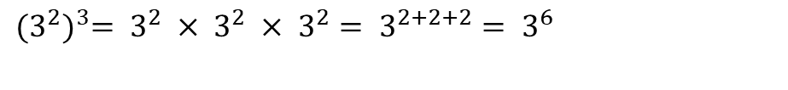
24
7
30
Date
Index Notation
EQ – How do I calculate the value of an integer to the power of a positive integer?
What is the power of a power index law?
${{(a}^{m})}^{n}$= $a^{m×n}$
Example
$${(3^{2})}^{3}= 3^{2} × 3^{2} × 3^{2}= 3^{2+2+2}= 3^{6}$$

Slide 13
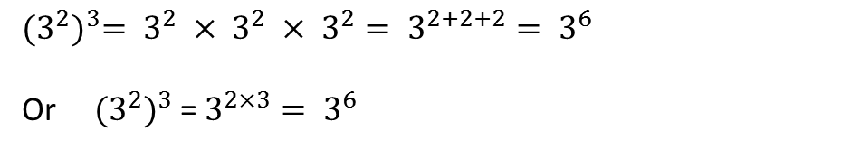
24
7
30
Date
Index Notation
EQ – How do I calculate the value of an integer to the power of a positive integer?
What is the power of a power index law?
${{(a}^{m})}^{n}$= $a^{m×n}$
Example
$${(3^{2})}^{3}= 3^{2} × 3^{2} × 3^{2}= 3^{2+2+2}= 3^{6}$$
Or ${ (3^{2})}^{3}$ = $3^{2×3}= 3^{6}$

Slide 14
24
7
30
Date
Index Notation
EQ – How do I calculate the value of an integer to the power of a positive integer?
What is the power of a power index law?
${{(a}^{m})}^{n}$= $a^{m×n}$
Example
$${(3^{2})}^{3}= 3^{2} × 3^{2} × 3^{2}= 3^{2+2+2}= 3^{6}$$
Or ${ (3^{2})}^{3}$ = $3^{2×3}= 3^{6}$
What is the zero index law?

Slide 15
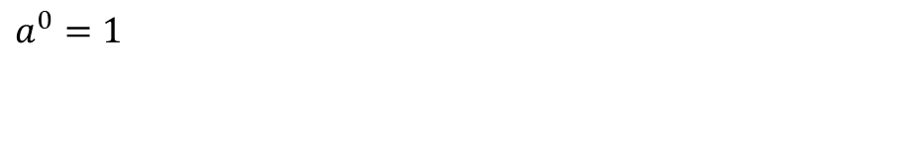
24
7
30
Date
Index Notation
EQ – How do I calculate the value of an integer to the power of a positive integer?
What is the power of a power index law?
${{(a}^{m})}^{n}$= $a^{m×n}$
Example
$${(3^{2})}^{3}= 3^{2} × 3^{2} × 3^{2}= 3^{2+2+2}= 3^{6}$$
Or ${ (3^{2})}^{3}$ = $3^{2×3}= 3^{6}$
What is the zero index law?
$$a^{0}=1$$

Slide 16
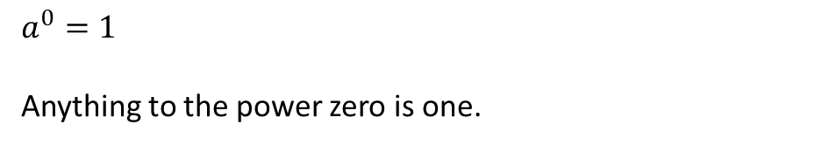
24
7
30
Date
Index Notation
EQ – How do I calculate the value of an integer to the power of a positive integer?
What is the power of a power index law?
${{(a}^{m})}^{n}$= $a^{m×n}$
Example
$${(3^{2})}^{3}= 3^{2} × 3^{2} × 3^{2}= 3^{2+2+2}= 3^{6}$$
Or ${ (3^{2})}^{3}$ = $3^{2×3}= 3^{6}$
What is the zero index law?
$$a^{0}=1$$
Anything to the power zero is one.

Slide 17
24
7
30
Date
Index Notation
EQ – How do I calculate the value of an integer to the power of a positive integer?
Example
(4 x 3)⁴

Slide 18
24
7
30
Date
Index Notation
EQ – How do I calculate the value of an integer to the power of a positive integer?
Example
Extended form
(4 x 3)⁴
(4 x 3) x (4 x 3) x (4 x 3) x (4 x 3)

Slide 19
24
7
30
Date
Index Notation
EQ – How do I calculate the value of an integer to the power of a positive integer?
Example
Extended form
Rearrange the product
(4 x 3)⁴
(4 x 3) x (4 x 3) x (4 x 3) x (4 x 3)
4 x 4 x 4 x 4 x 3 x 3 x 3 x 3

Slide 20
24
7
30
Date
Index Notation
EQ – How do I calculate the value of an integer to the power of a positive integer?
Example
Extended form
Rearrange the product
Write the answer in index form
(4 x 3)⁴
(4 x 3) x (4 x 3) x (4 x 3) x (4 x 3)
4 x 4 x 4 x 4 x 3 x 3 x 3 x 3
4⁴ X 3⁴

Slide 21
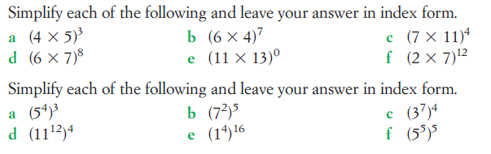
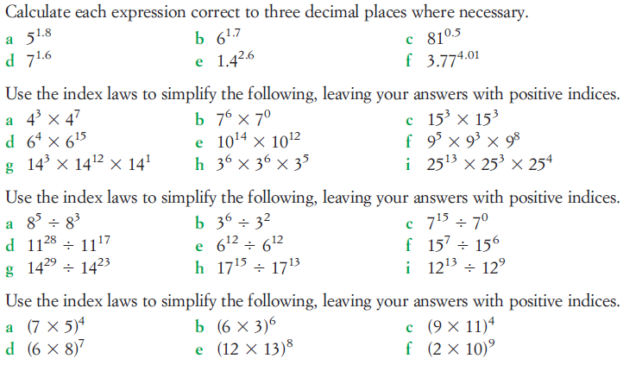

Slide 22
Notes Review
24, 7 ,30
Date
Title
Essential question
Notes complete
Notes complete with colour and diagrams
Questions completed
Contents page filed in
Formula page filled in

Slide 23
Homework
Review your notes and write a summary answering the essential question.

